Slide 1
Quantitative Analysis
&
Moving Averages
04/02/19 DSGT Workshop

Slide 2
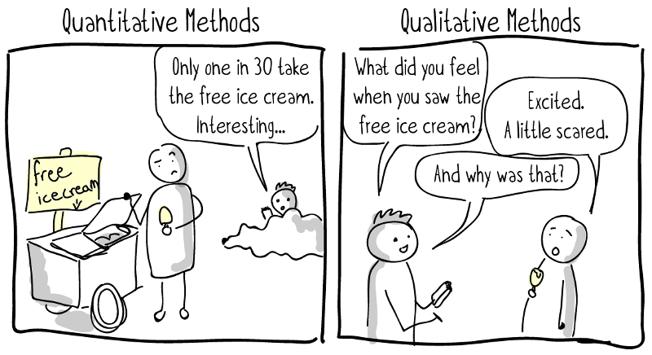
Quantitative vs Qualitative

Slide 3
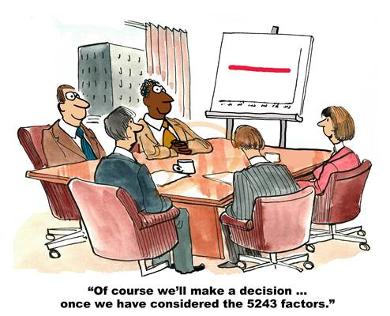

Slide 4
Probability and Decision Making
 | Yielding Strong Demand | Yielding Weak Demand
Designing New Product (Invest $10M) | $25M (P = 0.65) | -$5M (P = 0.35)
Enhancing Existing Product (Invest $3M) | $10M (P = 0.80) | $5M (P = 0.20)
Do Nothing (Invest $0M) | $3M (P = 0.75) | $1M (P = 0.25)

Slide 5
Probability and Decision Making
 | Yielding Strong Demand | Yielding Weak Demand
Designing New Product (Invest $10M) | $25M (P = 0.65) | -$5M (P = 0.35)
Enhancing Existing Product (Invest $3M) | $10M (P = 0.80) | $5M (P = 0.20)
Do Nothing (Invest $0M) | $3M (P = 0.75) | $1M (P = 0.25)
Design? Enhance? Or do nothing?

Slide 6
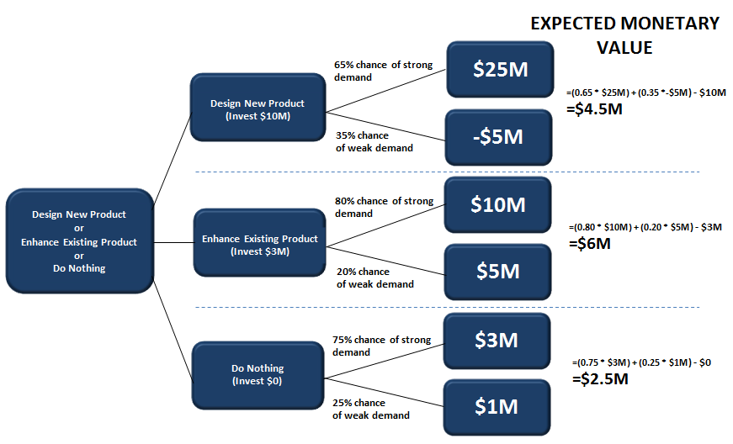
Decision Tree

Slide 7
Some Statistics
Significance Test A method of statistical inference that is used to assess the plausibility of hypotheses about a population.
Null Hypothesis (H₀) The technical term for the hypothesis that is tested in statistical significance testing is the null hypothesis. It is often denoted H₀.
Alternative Hypothesis (H_{a}) Opposite of the null hypothesis, which indicates the kinds of observations that will be taken as evidence against H₀.

Slide 8
Some Statistics
Test Statistic A number calculated from the sample which is used to test a null hypothesis.
Sampling Distribution of a Statistic The distribution of the statistic (i.e. its possible values and the proportions with which they occur) in the set of all possible random samples of the same size from the population.

Slide 9
Some Statistics
P-Value The probability, if the null hypothesis was true in the population, of obtaining a value of the test statistic which provides as strong or stronger evidence against the null hypothesis, and in the direction of the alternative hypothesis, as the value of the test statistic in the sample actually observed.
Significance Levels (ɑ-levels) Conventional reference levels to which the P-value is compared and determine whether the null hypothesis is rejected.

Slide 10
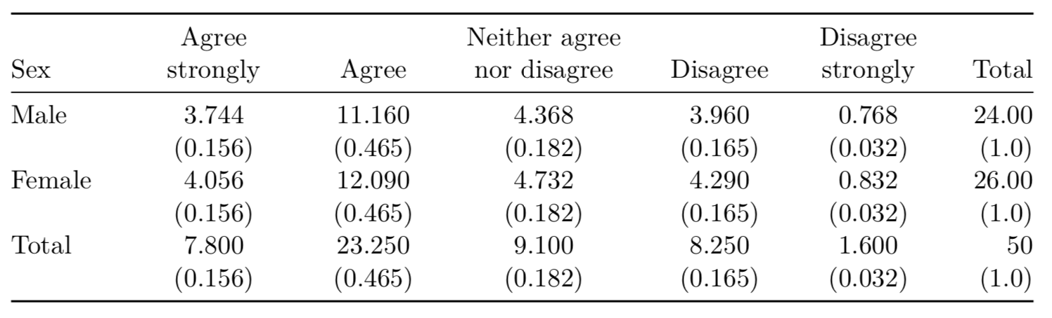

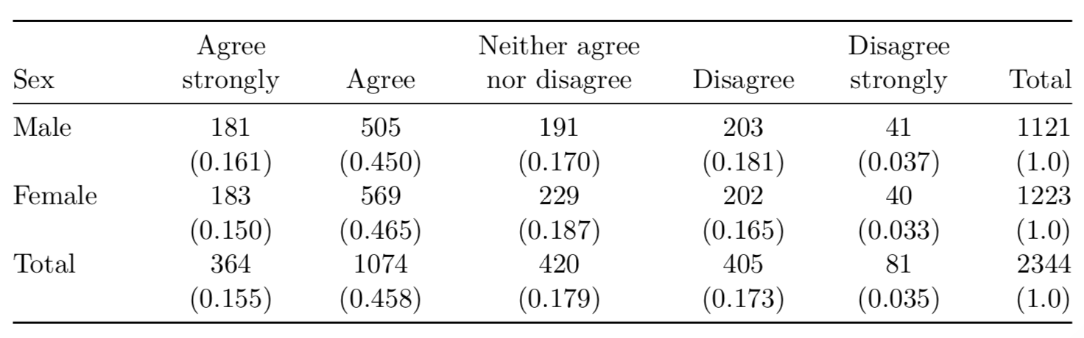
Statistical Inference
Population (frequencies in millions of people)
Sample

Slide 11
Hypothesis Testing
Data
Assumptions
Notes:
Data: Observations of two categorical variables
Assumptions for Chi-Square Tests
The two variables must be categorical variables
The expected frequencies f_{e} (the product of the row and column totals corresponding to the cell, divided by the total sample size) need to be large enough in every cell of the table

Slide 12
Hypothesis Testing
Population (frequencies in millions of people)
f_{e} = (row total)*(col total)/(total sample size)
= 364*1121/2344
f₀ = cell count = 181
Sample

Slide 13
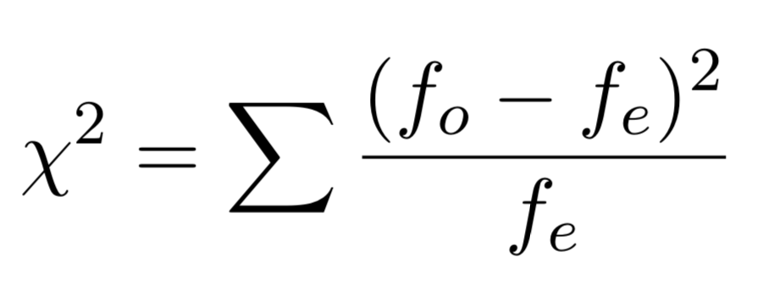
Hypothesis Testing
Data
Assumptions
Hypothesis Null hypothesis H₀: The two variables are statistically independent in the population. Alternative hypothesis H_{a} : The variables are dependent in the population.
Test Statistics
Notes:
Assumptions for Chi-Square Tests
The two variables must be categorical variables
The expected frequencies f_{e} (the product of the row and column totals corresponding to the cell, divided by the total sample size) need to be large enough in every cell of the table

Slide 14
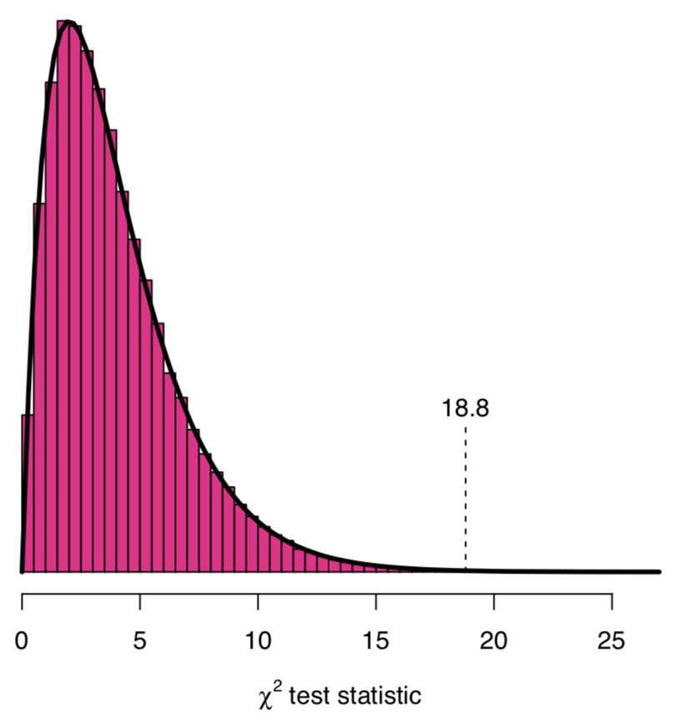
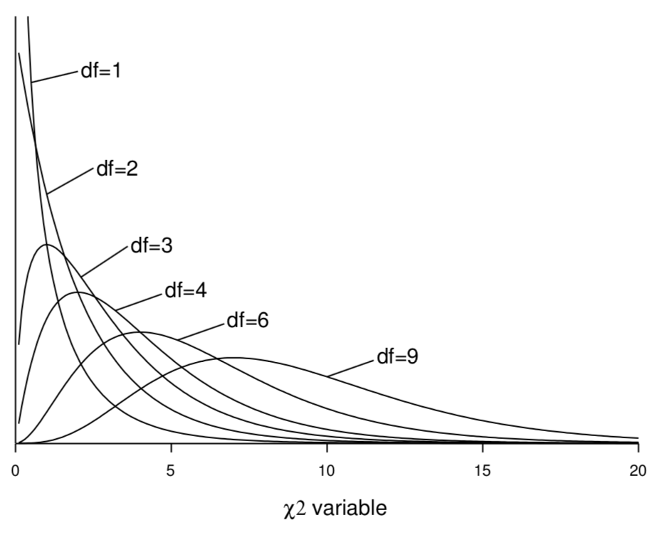
Hypothesis Testing: Sampling Distribution
For the χ² test statistic of independence:
df (degrees of freedom)
= (R − 1)(C − 1)

Slide 15
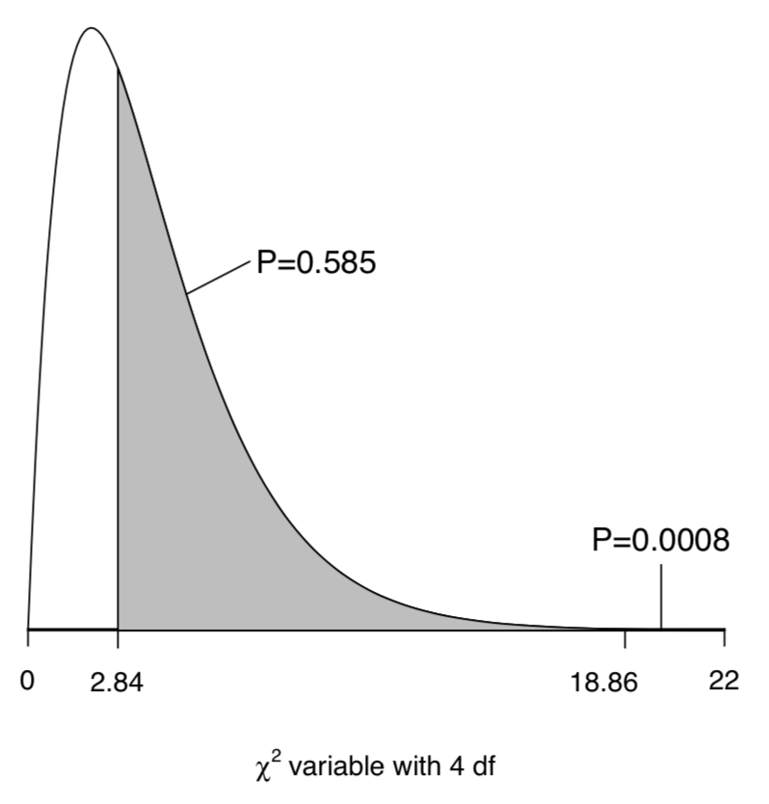
Hypothesis Testing: P-value
Recall:
P-value is the probability of obtaining a test statistic which provides stronger evidence against the null hypothesis (and in the direction of the alternative hypothesis) as the value of the test statistic in the sample actually observed

Slide 16
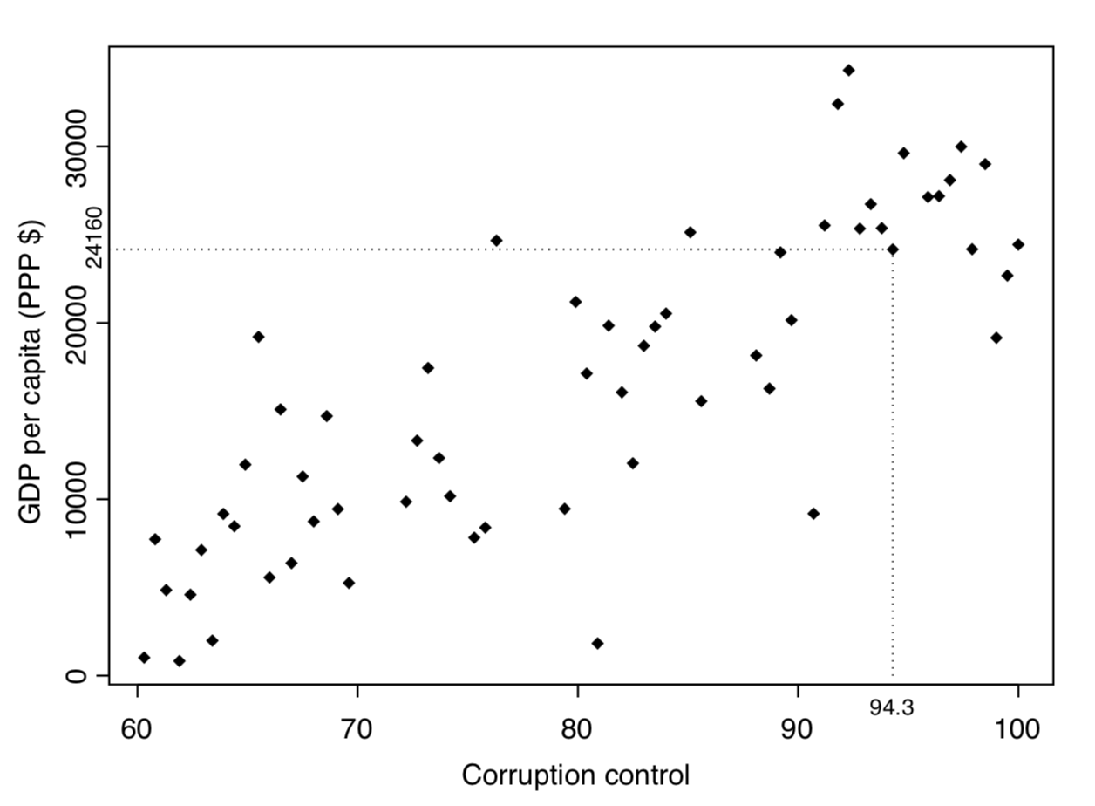
Graphical Method
Notes:
A scatterplot of Control of corruption vs. GDP per capita in the Global Civil Society data set, for 61 countries with Control of corruption at least 60. The dotted lines are drawn to the point corresponding to the United Kingdom.

Slide 17
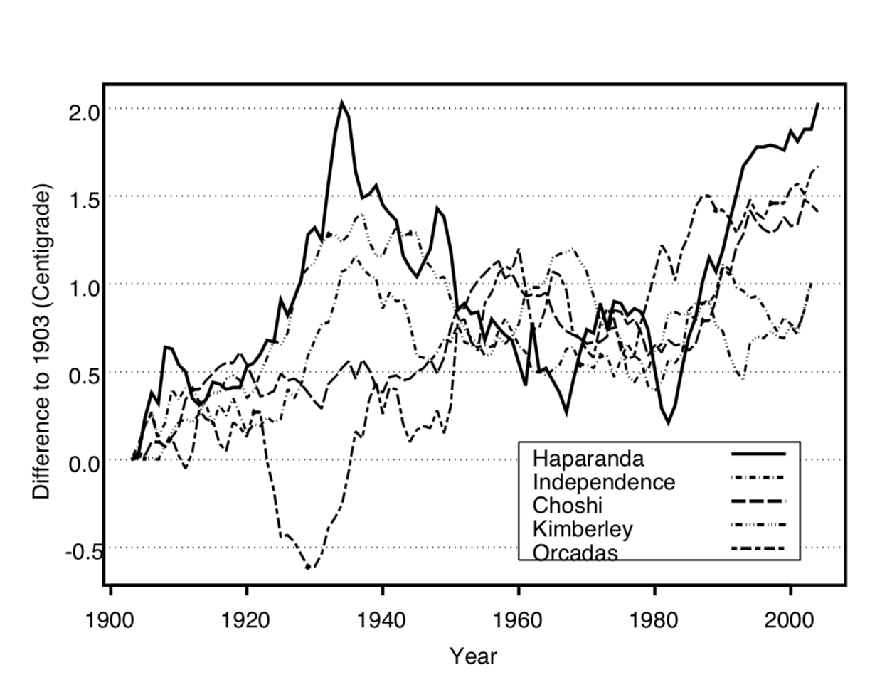
Graphical Method
Notes:
Changes of average annual temperature (11-year moving averages) from 1903 in five locations. Source: The GISTEMP database <data.giss.nasa.gov/gistemp/>

Slide 18
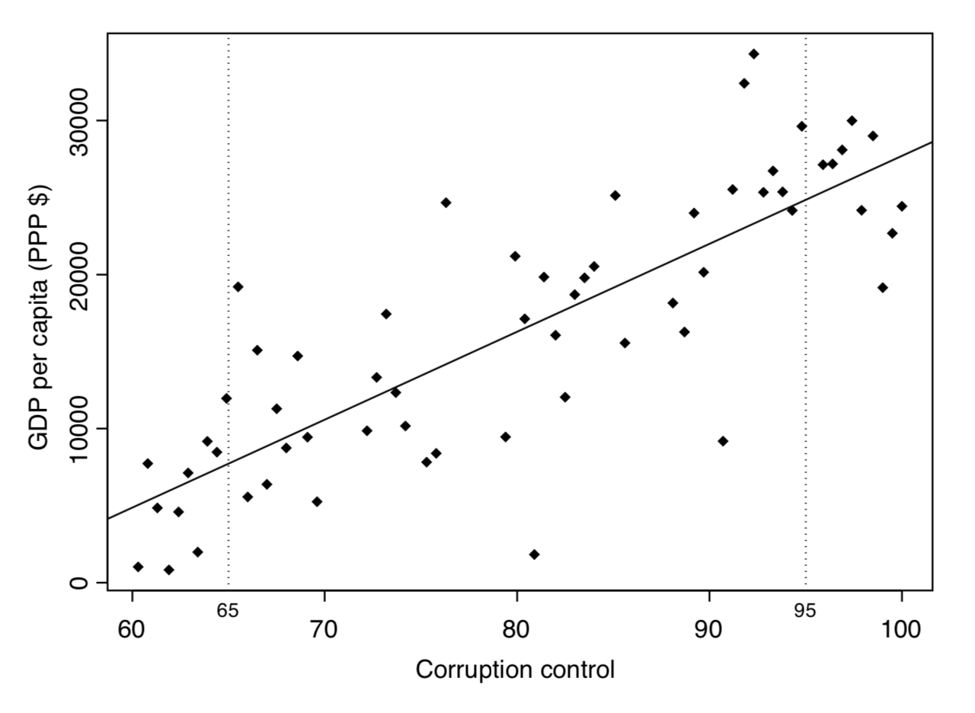
Linear Association
Notes:
A scatterplot of Control of corruption vs. GDP per capita in the Global Civil Society data set, for 61 countries with Control of corruption at least 60, augmented by the best-fitting (least squares) straight line (solid line).

Slide 19
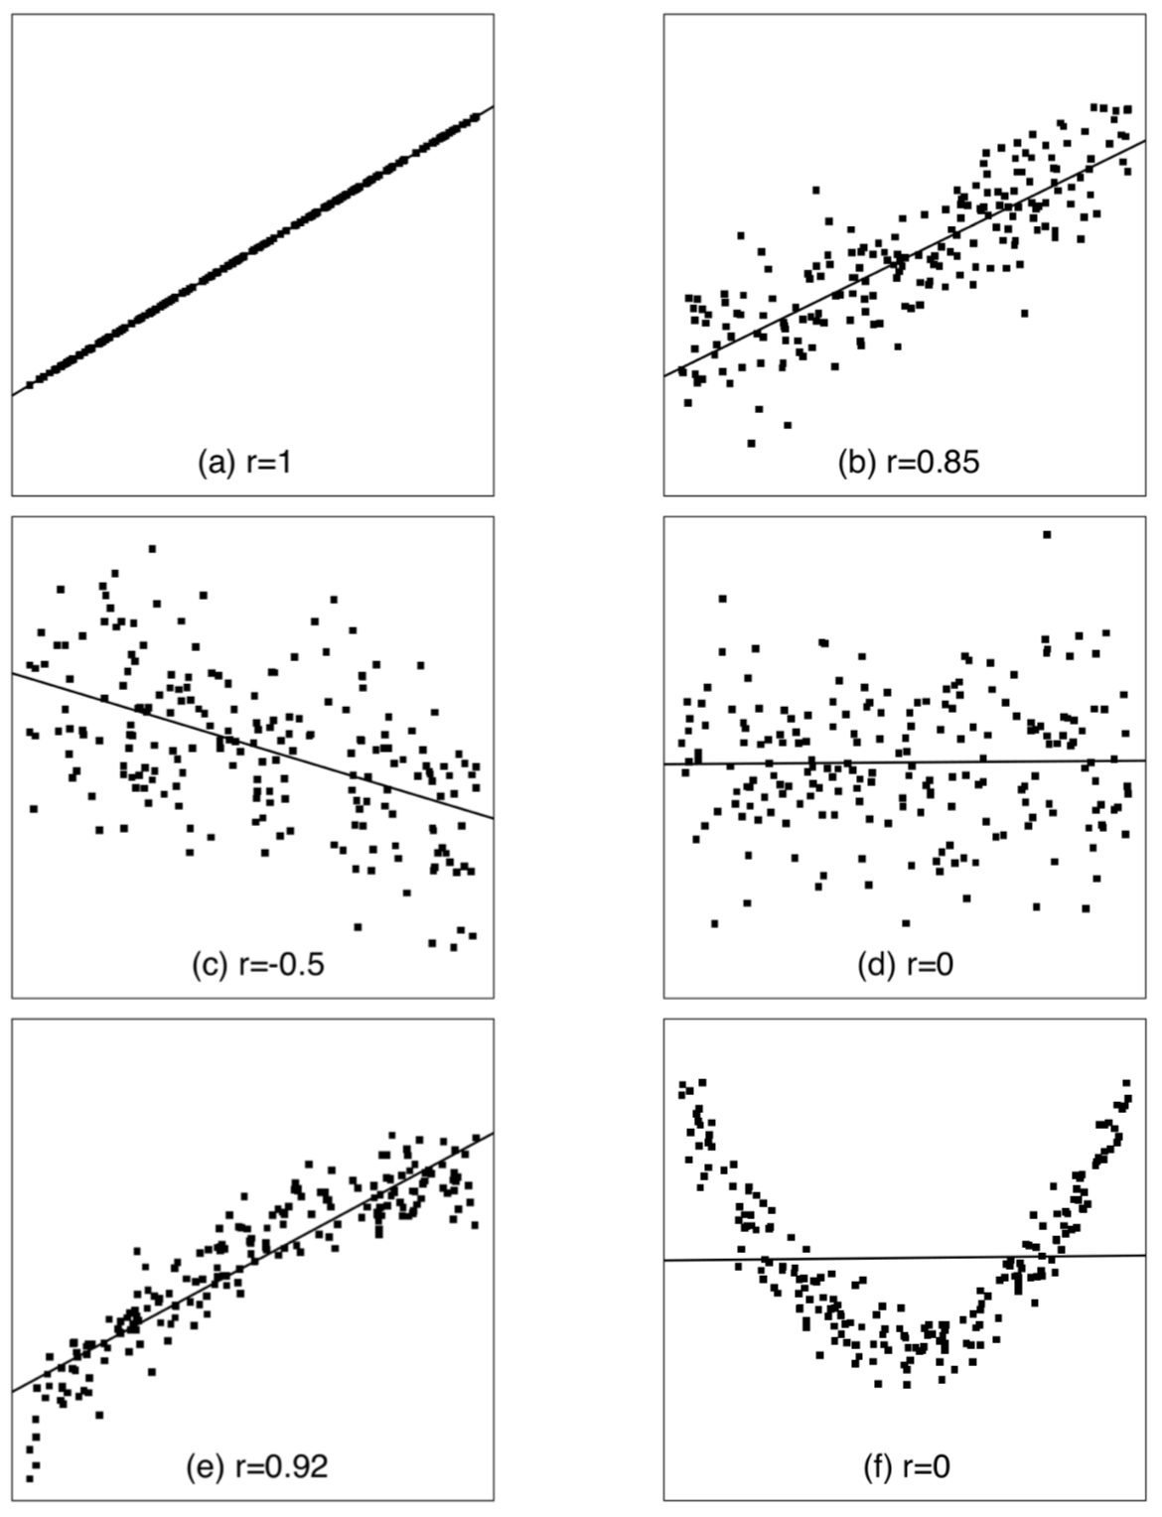
Linear Association
Notes:
Scatterplots of artificial data sets of two variables. Each plot also shows the best- fitting (least squares) straight line and the correlation coefficient r.

Slide 20
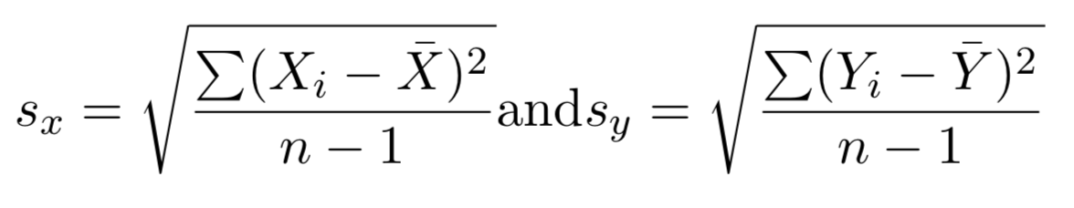
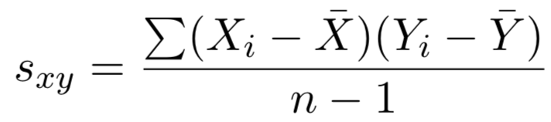
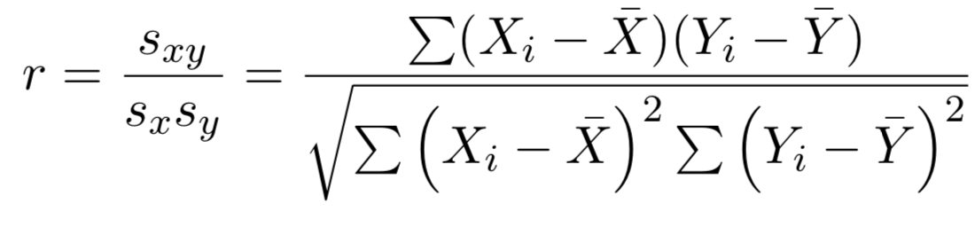
Covariance and Correlation
Variance
Covariance
Correlation Coefficient

Slide 21
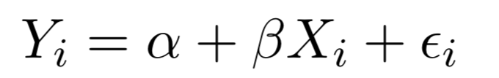
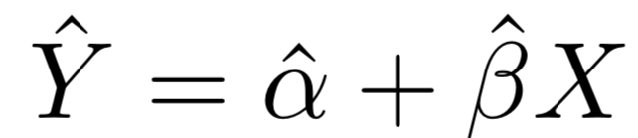
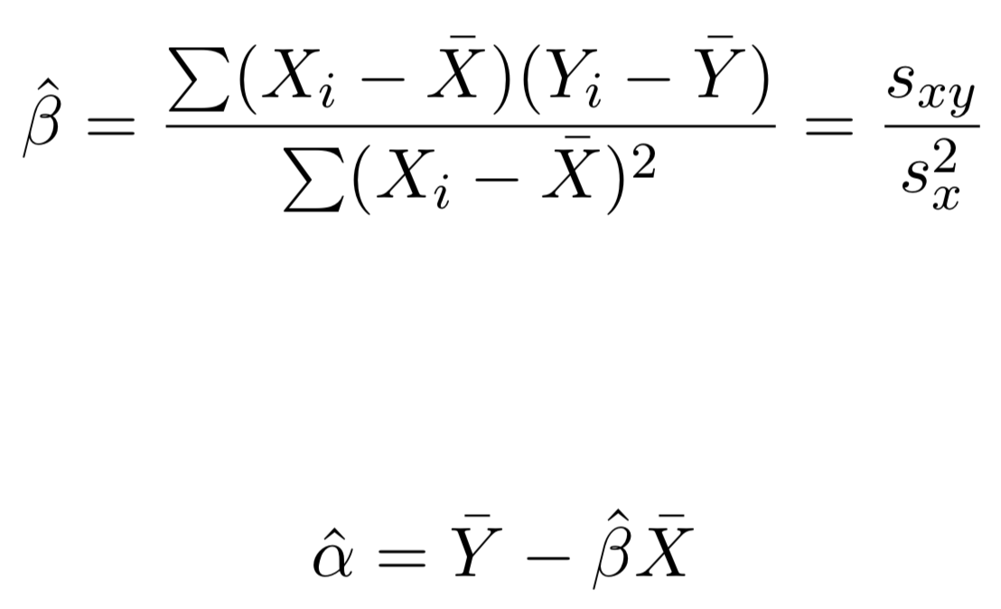
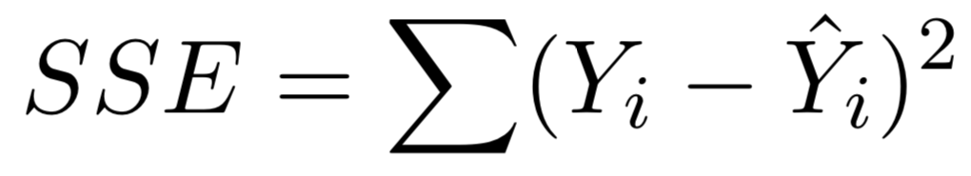
Simple Linear Regression Model
Model
Estimation
SSE - Sum of Squares of Error (RSS - Residual Sum of Squares)

Slide 22
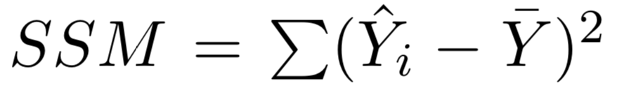
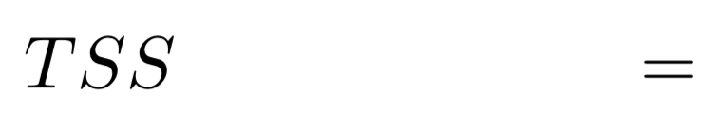
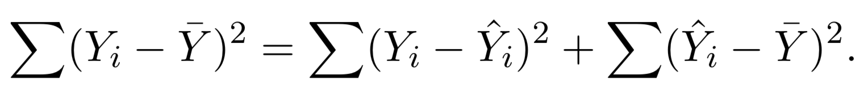
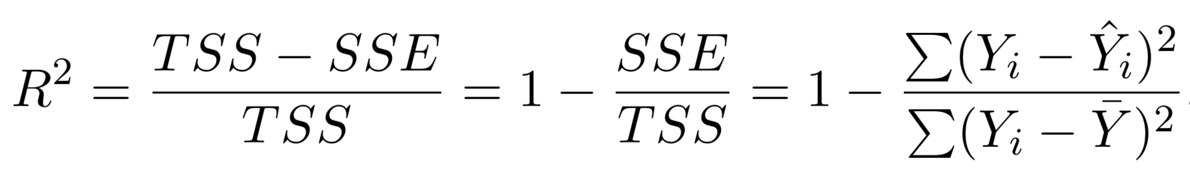
Simple Linear Regression Model
Model Sum of Squares (SSM)
Total Sum of Squares (TSS)
Coefficient of Determination (R²)
Notes:
Coefficient of Determination:
Measures the fraction of total variation in the dependent variable that is explained by the independent variable

Slide 23



ANOVA (Analysis of Variance)
29 28 25
30 29 28
31 27 27
31 30 29
29 29 29

Slide 24
ANOVA (Analysis of Variance)
10 11 12
12 14 13
18 19 17
24 23 25
36 38 37

Slide 25
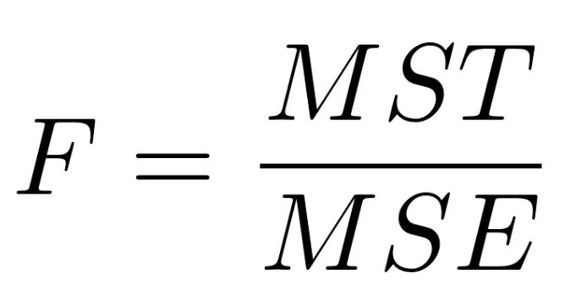
ANOVA (Analysis of Variance)
F-statistic
F = ANOVA coefficient
MST = Mean sum of squares due to treatment
MSE = Mean sum of squares due to error

Slide 26
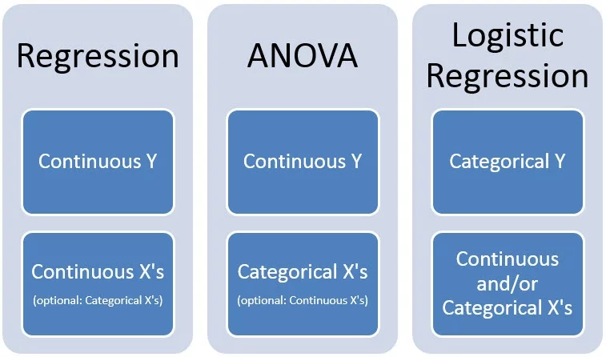
ANOVA (Analysis of Variance)

Slide 27
More Statistics
Models for categorical responses variables
Models for responses that are a length of time to some event
Event history analysis/survival analysis/lifetime data analysis
Hierarchical data
Longitudinal/panel data
Nested/multilevel data
Time series analysis
Descriptive multivariate analysis
Cluster analysis
Multidimensional scaling
Principal component analysis
Latent variable models
Notes:
Categorical responses variable
Logistic model (binary)
Multinomial logistic models (>2, unordered)
Ordinal regression models (>2, ordered)
Poisson regression
Loglinear models

Slide 28
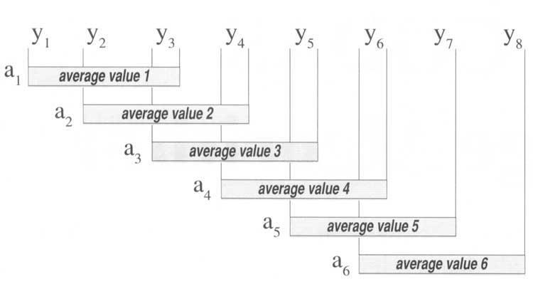
Moving Average
Simple Moving Average (SMA) (P1 + P2 + P3 + P4 + ... + Pn) / n
Exponential Moving Average (EMA) [Close - previous EMA] * (2 / n+1) + previous EMA

Slide 29
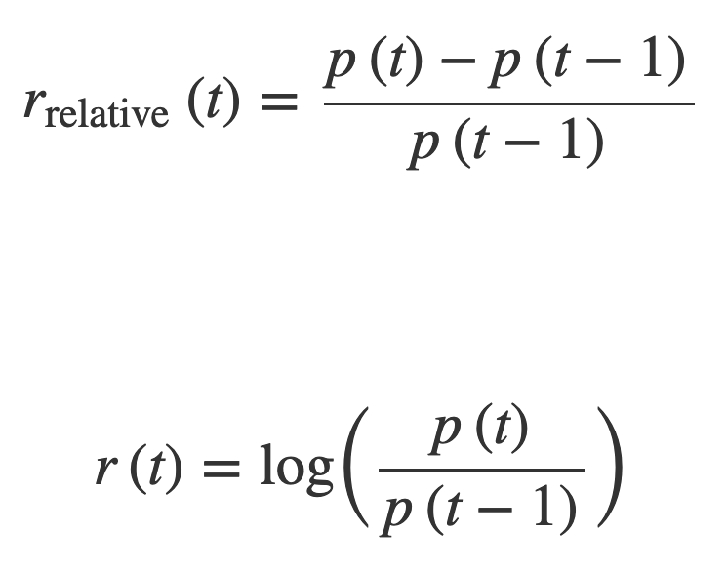
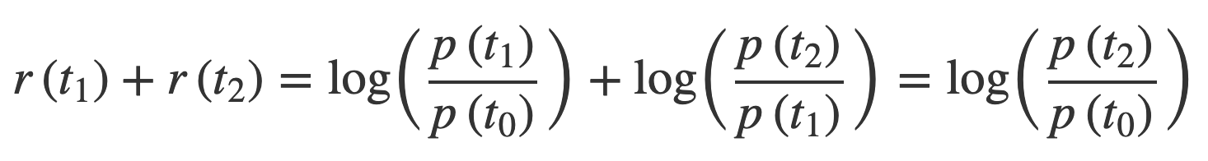
Moving Average
Relative Returns
Log-returns

